Slide 1


A Provider’s Toolbox:
4. Listening Skills
THE AWARDING BODY NETWORK

Slide 2
Session Overview
LEARN – LEAD- INSPIRE
- Based on recent research
  i.e., evidence of current situation, and what else is needed
Well done!
  Tweaking performance, recognising your strengths, working on refining skills
What and How?
  Definition and understanding importance of good feedback, and how to do it!
- Questions welcome :-)

Slide 3
Effective Listening
LEARN – LEAD- INSPIRE
Purpose:
Relates directly to giving feedback/goal setting
Building rapport
Encourages ownership
Develop confidence in candidate’s ability to solve their own problems
Considerations:
Environmental considerations
How to show engagement?
Barriers?
Interpretation
Listening or hearing?

Slide 4
Troubleshooting
LEARN – LEAD- INSPIRE
Problems:
- Time, place and situation
Language
Our interpretation/projection
Leading
Antidote:
SILENCE!
Patience
Plan ahead
Make notes

Slide 5
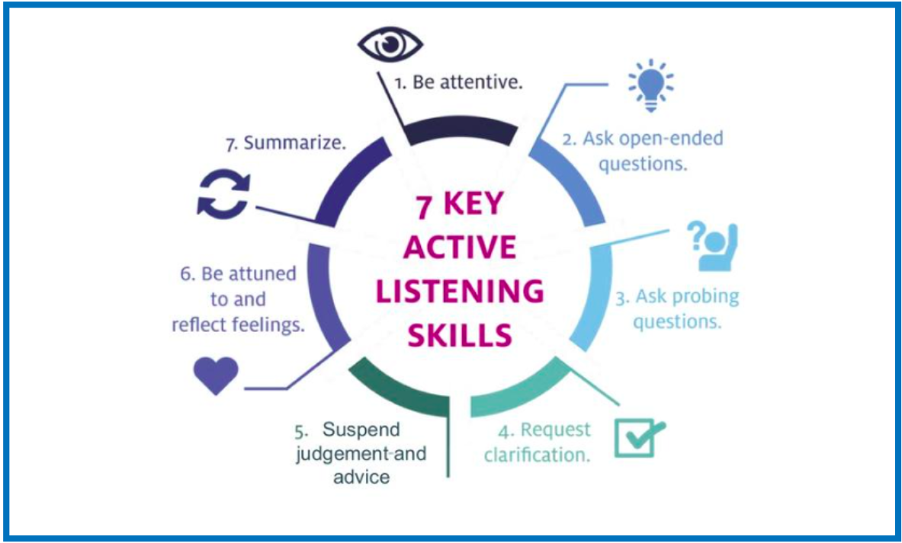
Active Listening
LEARN – LEAD- INSPIRE

Slide 6
Models
LEARN – LEAD- INSPIRE
*CommUNICATION TrianglE
*INPUT - OUTPUT - PROCESSING
MESSAGE RECEIVED
MESSAGE SENT MESSAGE UNDERSTOOD

Slide 7
Top Tips
LEARN – LEAD- INSPIRE
Listen not hearing
Listening not waiting
Stay focused
Walk and listen
Environment
Repeat back
Use their words
Summarise
Pause before Questions
Noises…
Distractions
Facade for questions
Lip service
Attention
Proximity
Impatience
Facial expression
Environment
Hurrying
Assumptions
Interrupting
Noises…

Slide 8
Key Points
Purpose - what is the point?
Think about the bigger picture - how will listening help you/them?
Consider responses
Consider resulting questions and their flow
Make notes - heads up
Building Rapport - reciprocal
Practice!
Action Plan and Reviewing

Slide 9
INSPIRE model
LEARN – LEAD- INSPIRE
I - Inspire and motivate your followers with a unified vision
N - Nurture an environment of team-focused goals
S - Set the example you want to see in your followers
P - Praise, and give constructive feedback to help your followers develop
I - Insist on setting high standards, relative to each individual
R - Recognise and respond to each individual’s needs
E - Encourage followers to create and implement their own solutions

Slide 10
One last thing…
LEARN – LEAD- INSPIRE
If in doubt, HEEAR:
- Humble
- Encouraging
- Empathetic
- Appropriate
- Rapport

Slide 11
Questions?
LEARN – LEAD - INSPIRE
samantha_mcelligott@hotmail.com

